Slide 1
Emerging Leaders
Your Evolution of Leadership
Col Kevin Johnson
Friday, March 19, 2021

Slide 2
Agenda
What is a Leader?
Followership
Leading Your Peers
1st Level Leader
2nd Level Leader
Strategic Leader

Slide 3
What is a Leader?
Task Master?
The Boss?
Coach?
Mentor?
Organizer?
Manager?
“You manage things; you lead people.” - Admiral Grace Murray Hopper

Slide 4
Followership

Slide 5
Followership
Are you coachable?
Can you smartly follow directions?
Not a lemming blindly following instructions
Can you work as a member of a team?
Are you reliable and responsible?
Do you show initiative?
"He who cannot be a good follower, cannot be a good leader.“ - Aristotle

Slide 6
Followership
You're not following, you're a leader-in-training
Put your team first
Believe in yourself and your leader
What you follow, not who

Slide 7
Leading Your Peers
The hardest group to lead
No authority
Focus on persuasion

Slide 8
Principles of Persuasion - Dr Robert Cialdini
Reciprocity
People, by nature, feel obliged to provide concessions to others if they’ve received favors from those same people
Commitment/consistency
Humans have a deep need to be seen as consistent
Once we’ve publicly committed to something or someone, we’re much more likely to go through and deliver on that commitment
Social Proof
People do what they observe other people do
We tend to have more trust in things that are popular or endorsed by people that we trust
Notes:
The Reciprocity Principle: In many social situations, we pay back what we received from others.
-- Psychology explains this by stressing that humans simply hate to feel indebted to others!
-- Offer the help someone, they will be more likely to help you later on.
Commitment & Consistency Principle: We tend to stick with whatever we’ve already chosen
-- Psychological perspective, this can be explained by the fact that people have aligned commitment with their self-image
-- Ask someone to commit to something verbally. They will be more likely to commit to it.
Social Proof: There’s nothing like feeling validated based on what others are doing.
-- Elevator experiment from 1960s

Slide 9
Principles of Persuasion - Dr Robert Cialdini
Authority
We have a tendency to obey authority figures
We follow people who look like they know what they’re doing
Liking
We are more likely to comply with requests made by people we like
Scarcity
We are always drawn to things that are exclusive and hard to come by
Notes:
Authority: Not talking being a dictator
-- It’s easier to trust an authority figure in the field than it is to do your own research on any given topic.
Liking:
-- For whatever reason, people we like tend to have more perceived credibility than those that we do not like
-- This explains why we trust word-of-mouth recommendations
Scarcity:
-- We tend to assume that things that are difficult to obtain are usually better than those that are easily available.
-- So the principle of scarcity draws upon this belief by creating a sense of urgency

Slide 10
1st Level Leader
2022
Technically smart
First time supervising
Are you ready?

Slide 11
1st Level Leader
Responsible for getting team to execute tasks
Looked at as the expert
Often the primary trainer

Slide 12
1st Level Leader
How do I do that???????
Lead by example
Be a coach
Practice patience
May have to micromanage until trust is built
Everyone is different – adjust as necessary

Slide 13
1st Level Leader
Team building
Principles of Persuasion still apply
The power of “Please”
How you treat people goes a long way
You are trying to train someone to be your replacement
Start with “Why”

Slide 14
2nd Level Leader
2023
Technically smart in your field
Experience supervisor
What’s changed???

Slide 15
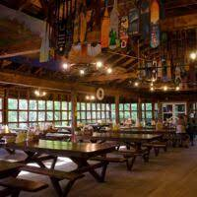
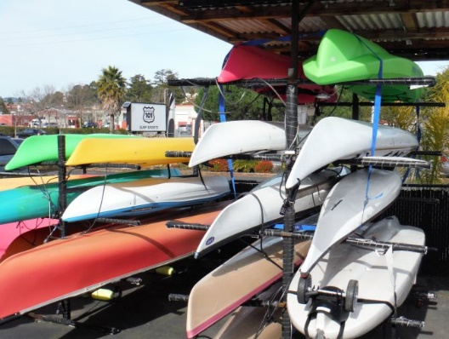
2nd Level Leader
May not be technically smart in all areas
Knows their roles and importance
Translates general direction to tasks
Integrates efforts
Manages resources
Sets priorities

Slide 16
2nd Level Leader
Focus is on setting teams up for success
Continue to be a coach
Hard Lesson – Finding your personal value
May not be an individual contributor

Slide 17
Strategic Leader
2024
Very Experience supervisor
Understands the business
What’s changed???

Slide 18
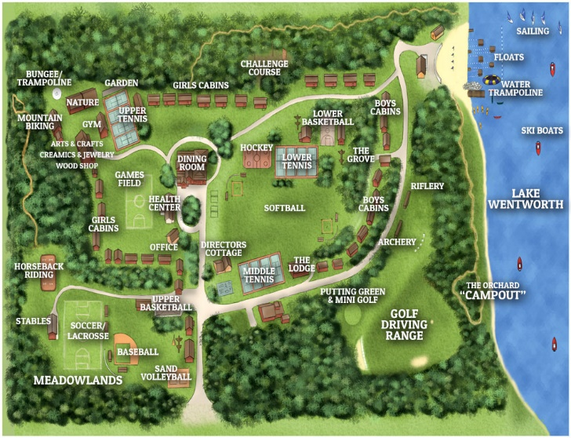
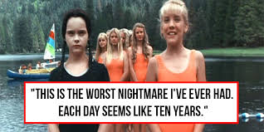
Strategic Leader

Slide 19
Strategic Leader
Sets the climate and culture
Share your priorities and expectations
Say it often, say it again, and again, and…
Sets the vision
Focus on larger issues and long term goals
Mentors lower leaders
Give general guidance – trust them
Give left and right boundaries
Freedom to operate

Slide 20
Strategic Leader
Focuses externally
Builds partnerships
Brings resources that you may not have internally
Don’t forget your roots
Be the leader you wanted to follow

Slide 21
Leadership Soup

Slide 22
Questions?
Col Kevin Johnson
ksjohnson95@gmail.com
https://www.linkedin.com/in/ksjohnson95/

